Slide 1
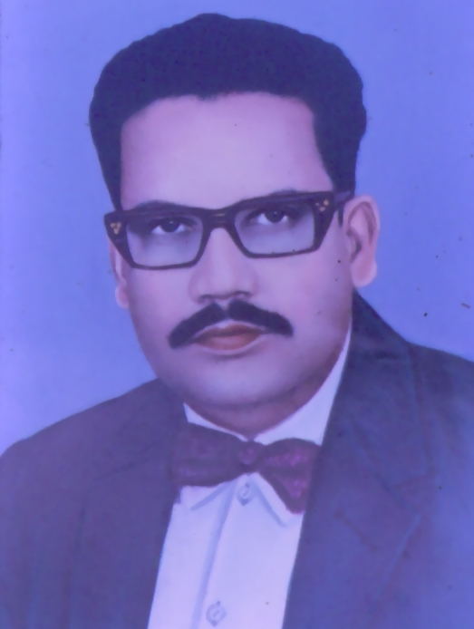
PROF. / DR. A J NARENDRAN
- M B B S – Mysore Medical College, 1958
- F R C S - Edinburgh
- Joined Government Service – 1962
- Retired from – Bangalore Medical College
- Founder Chairman ASI – KSC
A great teacher, excellent surgeon /
researcher and a good administrator

Slide 2
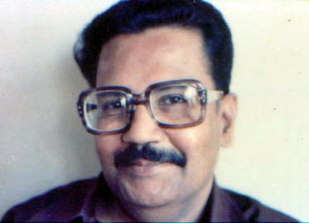
PROF. / DR. A J NARENDRAN
- Founder Chairman – Ostomates India.
- National Vice –President IMA 1980- 82
- Member governing Council ASI
- Medical Superintendent KMIO Bangalore
- He was involved in various social activities
- Was a free Mason and Rotarian
1. Founded Bangalore Freemasons’ society and study circle
2. Became Asst. Regional Grand master
- Died in the year 1989

